Slide 1

BHARATI VIDYAPEETH’S COLLEGE OF ENGINEERING A-4, PASCHIM VIHAR, ROHTAK ROAD, NEW DELHI OPINION MINING AND SENTIMENT ANALYSIS
UNDER THE GUIDANCE OF
Ms. Poonam Verma
SUBMITTED BY
SAKSHAM ARORA (02351202713)
VINit goel (02851202713)
ANKIT JAIN (03051202713)
Shashank shekhar(04151202713)
may , 2017

Slide 2
TOPICS TO BE COVERED
Introduction
Techniques
Problem Statement
Objective
Research Methodology
Dataset
Manual Annotations
Lexicon Classifier
Machine Learning
Hybrid Approach
Results without Neutral Classes
5. Limitations & Future Scope
6. Application Areas
7. References

Slide 3
INTRODUCTION
Sentiment analysis (also known as opinion mining) refers to the use of natural language processing, text analysis and computational linguistics to identify and extract subjective information in source materials
Sentiment analysis is widely applied to reviews and social media for a variety of applications, ranging from marketing to customer service. It has been practiced on various fields such as movie reviews, hotel reviews, product reviews and services .
Sentiment analysis aims to determine the attitude of a speaker or a writer with respect to some topic or the overall contextual polarity of a document.

Slide 4
Techniques
The approaches to Sentiment Analysis or opinion mining :
Lexicon
Machine Learning
Hybrid Analysis
Lexicon based method uses sentiment dictionary having sentiment words and correlate them with dataset to find the sentiment direction.
Machine learning based approach deals with data collection, training data and classification .
Hybrid approach which could collectively exhibit the accuracy of a machine learning approach and the speed of lexical approach.

Slide 5
Classification of Hotel Reviews
Opinion Mining is a phenomenon to guess or predict the meaning of what the customer is trying to imply through its comments. A hotel consists of a lot of amenities for a guest. All these amenities are responsible for deciding that whether a guest would like it there or not. The facilities & regards the guest get, forms an impression in the heart & brain either positive or negative.
Whether the hotel is the place to stay or not! This is exactly what the
classifier aims at predicting . The classifier can help in reading for the valuable
customers as well as it helps the hotel so as to improve and increase the pace in
the cut throat business.
It also can be used as an application in recommendation systems as the guest’s verdict can help to tell the improvements that need to be done and also with its experience, other people can enjoy the amenities to the fullest. The verdict of a particular person may or may not be genuine but a whole lot can help to decide

Slide 6
Objectives of the study
The main purpose of this project “Opinion Mining and Sentiment Analysis” is to delve into the wide domain of Opinion Mining and Natural Language Processing. The sentiment analysis is a complex process that involves 5 different steps to analyse sentiment data. These steps are: data collection, text preparation, sentiment detection, sentiment classification and presentation of output.
We aim to implement this by creating an application which will use a hybrid approach to classify reviews of hotels into sentimental categories like positive, neutral and negative.
Hotel will be judged in food, price, locality, and service using the reviews and development of technique that uses both lexicon features and machine learning algorithm is sole focus of the project .

Slide 7
RESEARCH METHODOLOGY
In our research project, we will take the Hotel reviews dataset and apply manual annotation on it . The review will be classified into sentiment classes manually and also the hotel will be judged on food , price ,service and locality which will be an integral part of the project for future commercial uses.
The second phase will see the different machine learning algorithms to be applied on the dataset and the efficiency of each will be calculated .
The final phase of the project will be the development of hybrid technique which is combination of machine learning and lexicon technique for sentiment classification of the hotel reviews.

Slide 8
DEVELOPING PROJECT
Manual annotation done on 2500+ reviews.
Classifying the dataset using the classifier using lexicon approach.
Applying machine learning algorithms to the dataset.
Devising an hybrid approach for sentiment analysis of hotel reviews.

Slide 9
DATASET
Used the TripAdvisor Data Set for our research work in sentiment analysis.
Parsed reviews used were crawled from http://www.tripadvisor.com
The Meta Data includes: Author, Content, Date, No. of Readers, No. of Helpful Judgment and Overall Rating.
Freely available at: http://times.cs.uiuc.edu/~wang296/Data/

Slide 10
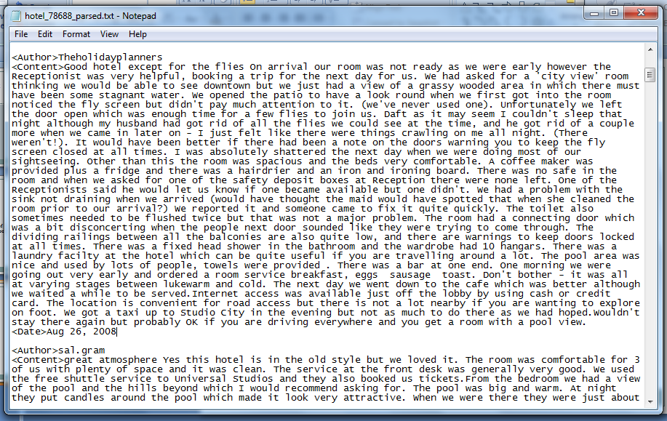
The Dataset

Slide 11
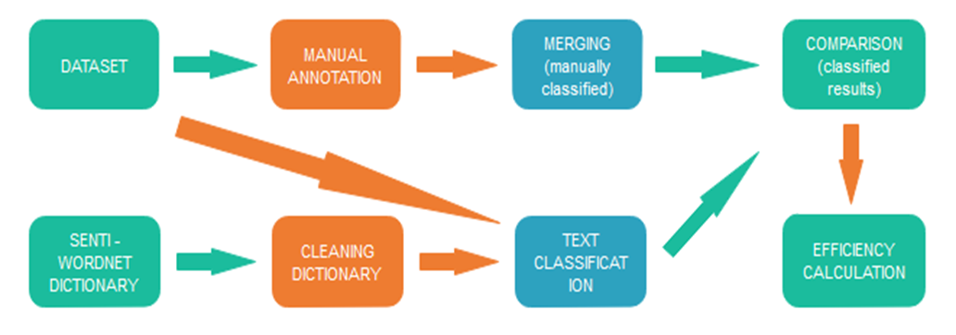
LEXICON FRAMEWORK
A cumulative interoperability of Lexicon and ML Based Sentiment Analysis to improve upon the output of Hybrid Sentiment Analysis.
Lexicon-Based Sentiment Analysis

Slide 12
MANUAL ANNOTATION
WE INTRODUCED THESE 5 CLASS TAGS IN THE DATSET . AFTER EACH REVIEW A TAG ACCORDING TO THE REVIEW WOULD BE ADDED FOR MANUAL CLSSIFICATION.
<Class>Positive
<Class>StronglyPositive
<Class>Negative
<Class>StronglyNegative
<Class>Neutral
We Classified 2500+ reviews manually .

Slide 13
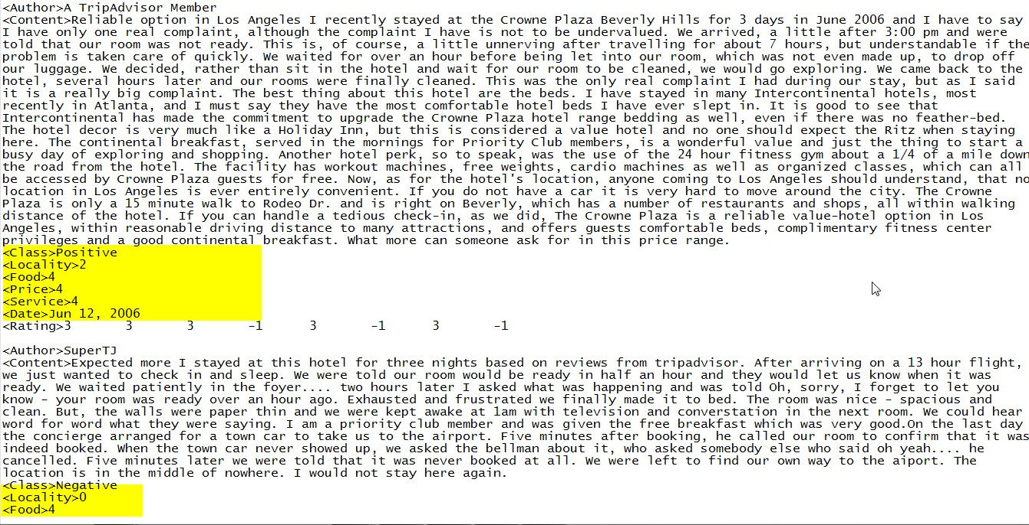
MANUAL ANNOTATION
WE INTRODUCED THESE 4 TAGS IN THE DATASET. AFTER EACH REVIEW A TAG ACCORDING TO THE REVIEW WOULD BE ADDED FOR MANUAL CLSSIFICATION.
The hotel will be judged on locality , food , price , service after reading the reviews on the rating of 1 to 5 , 1 being the worst and 5 being the best.

Slide 14
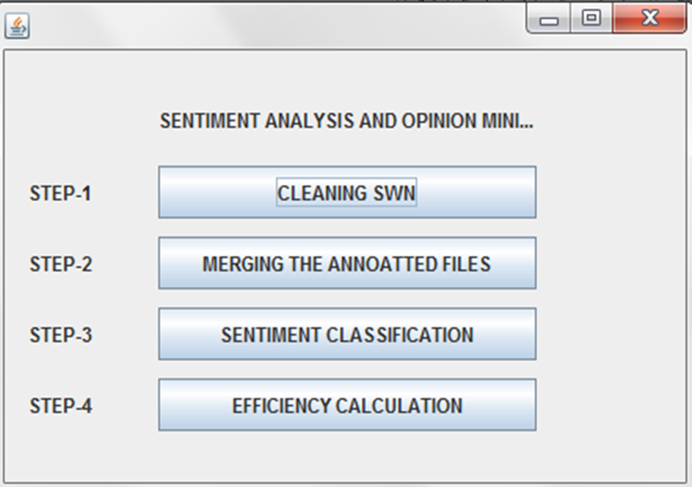
DEVELOPING THE CLASSIFIER
Cleaning the Senti Wordnet dictionary.
Using Trie data structure to develop classifier.
Classifying the dataset using the classifier
Comparing the manual annotated results with the classifier results and calculating efficiency.

Slide 15
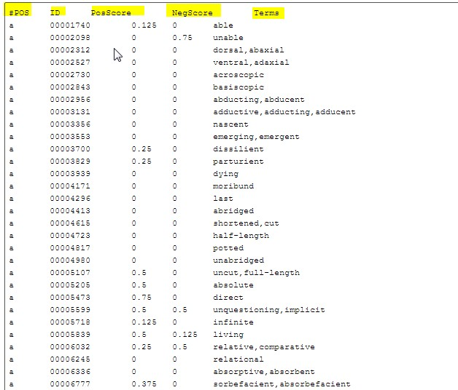
Cleaned SWN

Slide 16
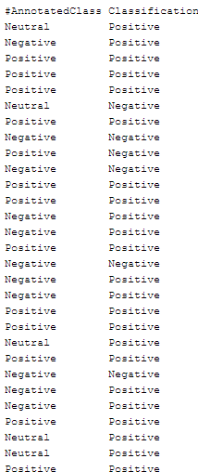
Calculating Efficiency

Slide 17
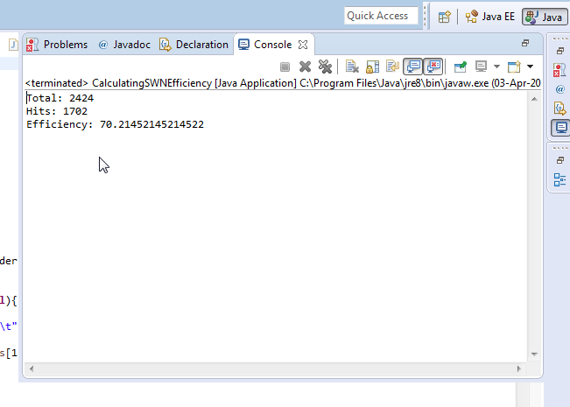
Efficiency of classifier

Slide 18
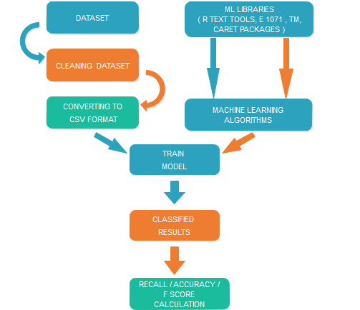
MACHINE LEARNING

Slide 19
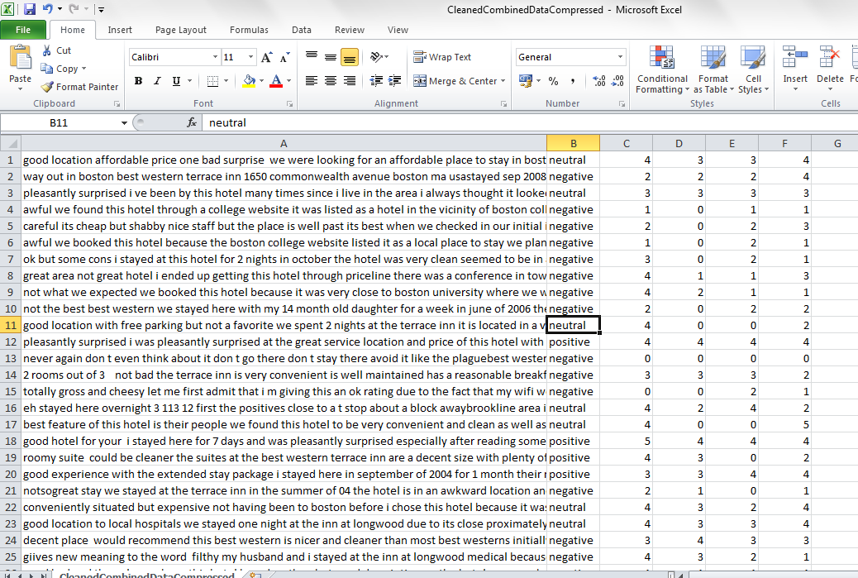
CSV DATASET FOR MACHINE LEARNING

Slide 20
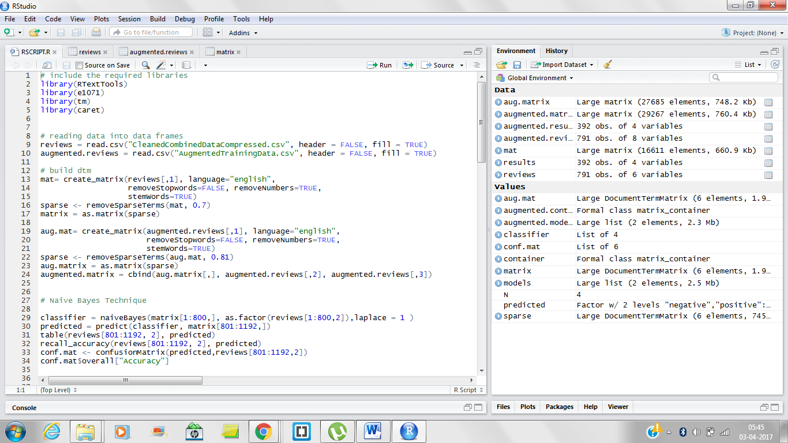
APPLYING MACHINE LEARNING TECHNIQUE ON DATASET

Slide 21
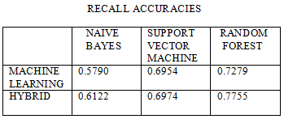
RESULTS of machine learning

Slide 22
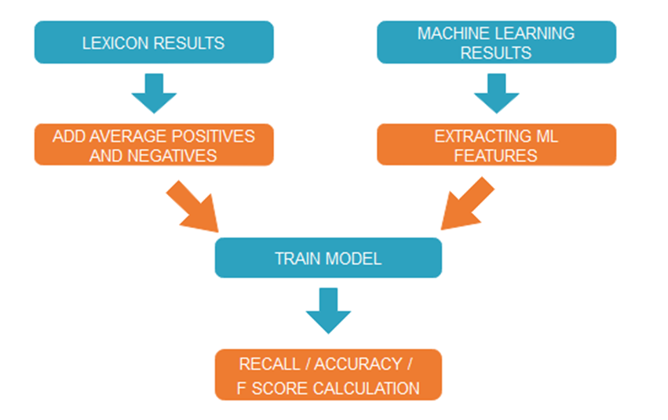
HYBRID APPROACH

Slide 23
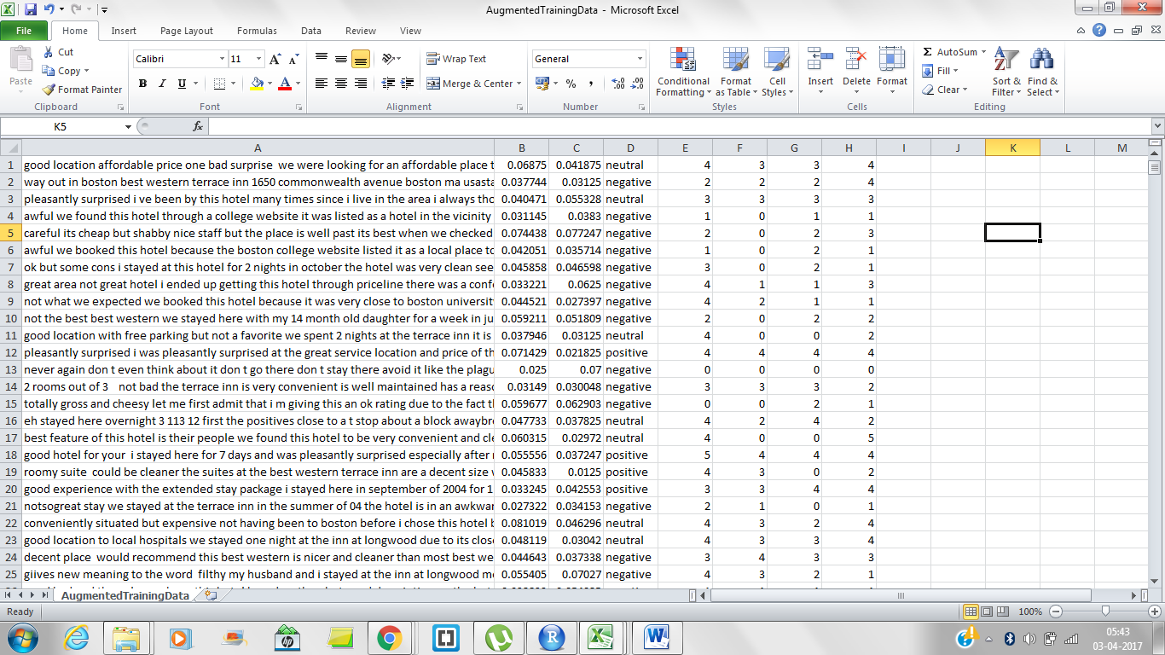
CSV FOR HYBRID DATASET

Slide 24
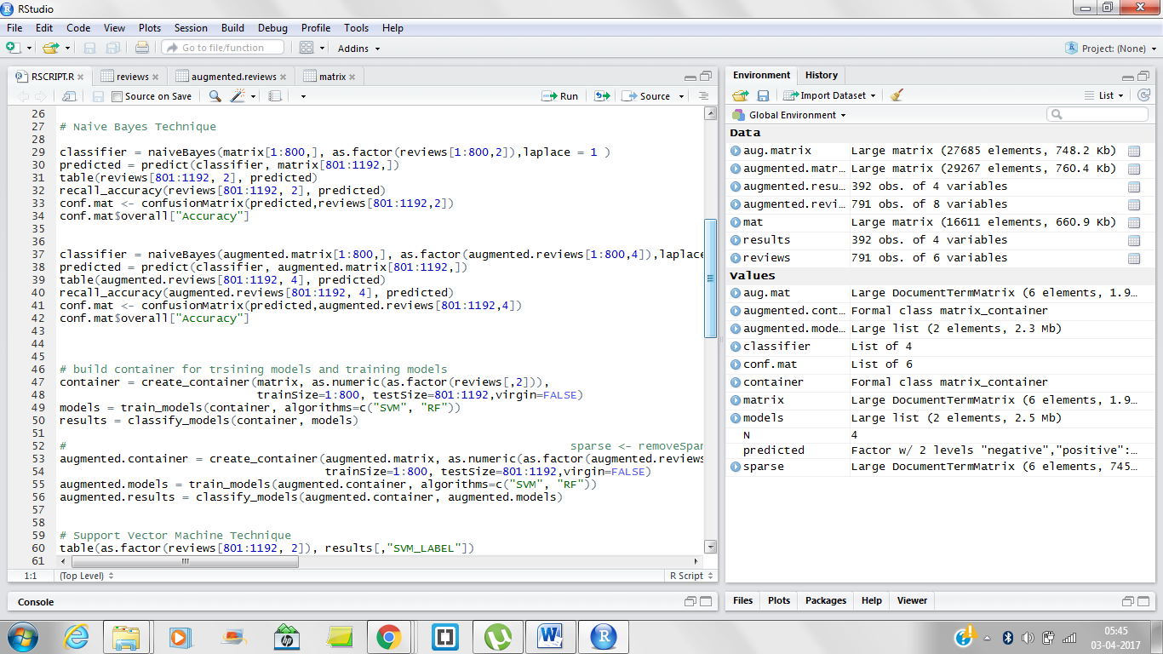
APPLYING MACHINE LEARNING ON HYBRID DATASET

Slide 25
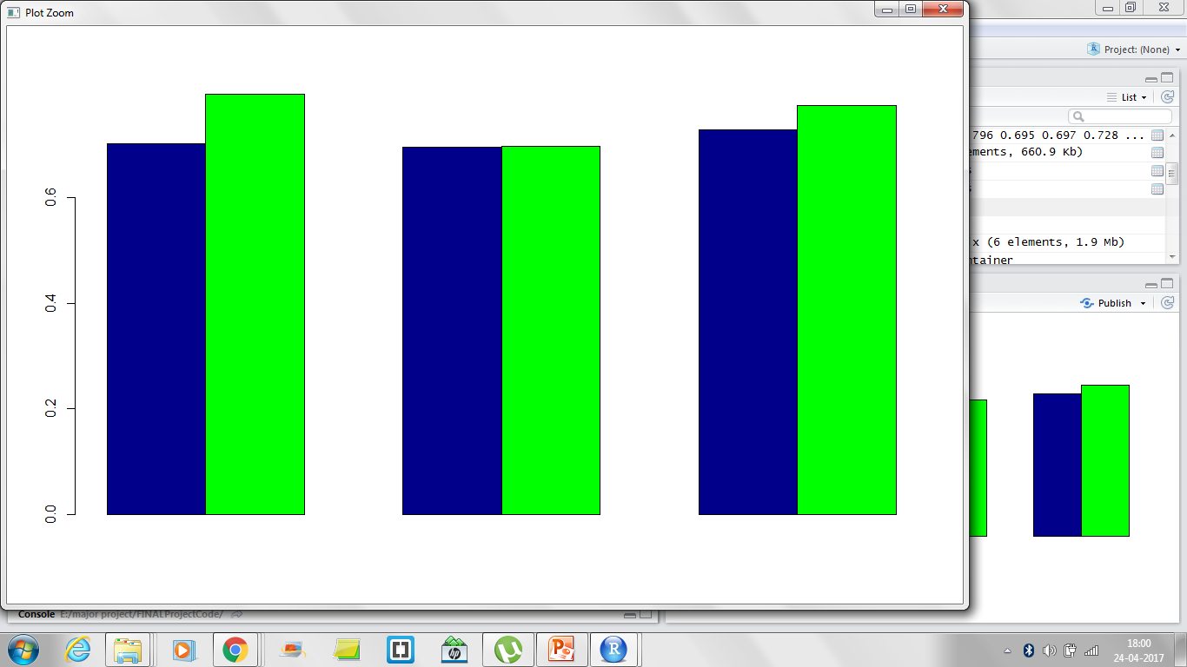

Slide 26
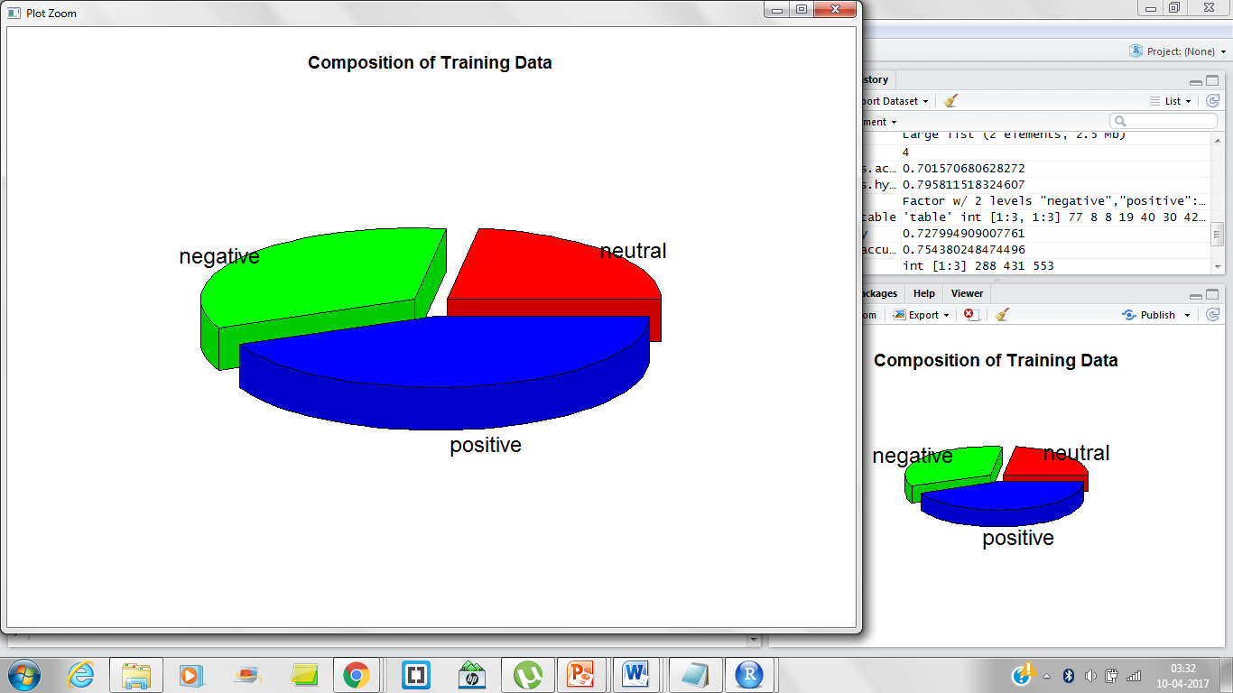
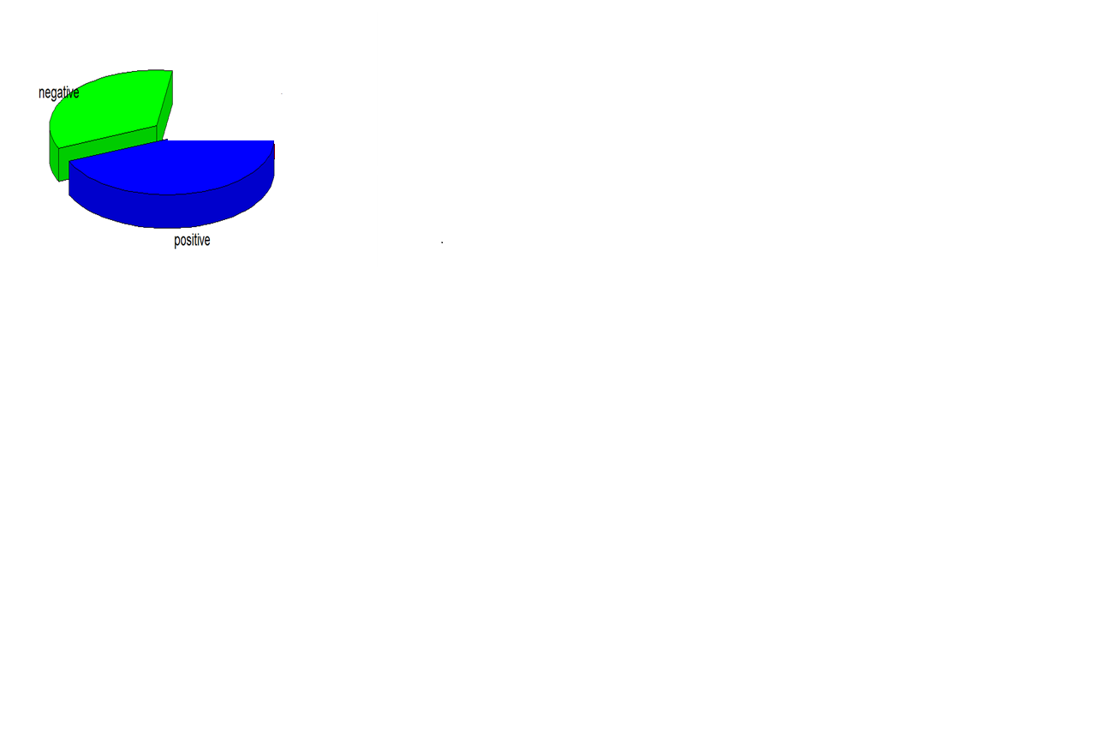
RESULTS WITHOUT NEUTRAL
Composition of Training Data

Slide 27
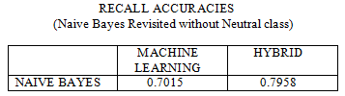
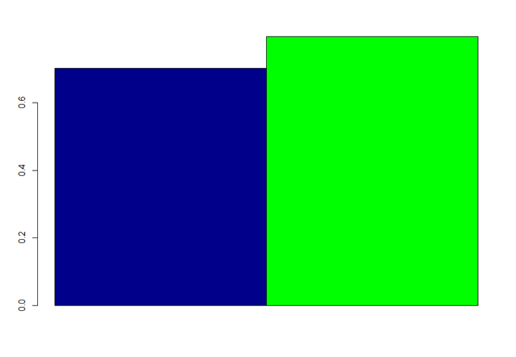

Slide 28
LIMITATIONS
Performance degrades drastically with the exponential growth of the size of dictionary (number of words).
The efficiency is limited when the neutral class is used in the training data.
FUTURE SCOPE
Developing a web application and integrating the Sentiment Analysis into commercial space.
Modifying dictionary based approach
Developing machine learning algorithms/techniques to increase the efficiency of the classifiers in neutral class and training the classifier accordingly.

Slide 29
APPLICATION AREAS OF PROJECT
Sentiment analysis is in demand because of its efficiency. Thousands of text documents can be processed for sentiment (and other features including named entities, topics, themes, etc.) in seconds, compared to the hours it would take a team of people to manually complete.
Computing customer satisfaction metrics
You can get an idea of how happy customers are with your products from the ratio of positive to negative tweets about them.
Identifying detractors and promoters
It can be used for customer service, by spotting dissatisfaction or problems with products. It can also be used to find people who are happy with your products or services and their experiences can be used to promote the products.

Slide 30
REFERENCES
[1] Esuli A, Sebastiani F. , "SentiWordNet: A Publicly Available Lexical Resource for Opinion Mining", Proceedings from International Conference on Language Resources and Evaluation (LREC) , Genoa, 2006
[2] Ohana, B. & Tierney, B. , "Sentiment Classification of reviews using SentiWordNet" , 9th.IT&T conference , Dublin,2009
[3] N. Godbole, M. Srinivasaiah, and S. Skiena,: "Large-scale sentiment analysis for news and blogs ", 2007
[4] K. Yessenov , S. Misailovi´c : "Sentiment Analysis of Movie Review Comments ",Spring, 2009
[5] Baccianella S., Esuli A., & Sebastiani F., "SENTIWORDNET 3.0: An Enhanced Lexical Resource for Sentiment Analysis and Opinion Mining ",Italy
[6] K. Dave, S. Lawrence, and D. M. Pennock,: Mining the peanut gallery: Opinion extraction and semantic classification of product reviews (2003) 519-528 .
[7] M. Bautin, L. Vijayarenu & S. Skiena ,"International Sentiment analysis for News and Blogs",NY
[8] Akshay Amolik, Niketan Jivane, Mahavir Bhandari Dr.M.Venkatesan “Twitter Sentiment Analysis of Movie Reviews using Machine Learning Techniques.” International Journal of Engineering and Technology (IJET), Vol 7 No 6 Dec 2015-Jan 2016
[9] W. Kasper, M. Vela ," Sentiment Analysis for Hotel Reviews", DFKI GmbH ,2011
[10] S. Baccianella, A. Esuli, and F. Sebastiani, “Multi-facet rating of product reviews,” Proceedings of the 31th European Conference on IR Research on Advances in Information Retrieval, ser. ECIR ’09. Berlin, Heidelberg: Springer-Verlag, 2009, pp. 461–472.
[11] U. Waltinger, “Germanpolarityclues: "A lexical resource for german sen- timent analysis,” Proceedings of the Seventh International Conference on Language Resources and Evaluation (LREC), 2010.
[12] Hatem Ghorbel and David Jacot. 2011," Further experiments in sentiment analysis of french movie reviews", In Advances in Intelligent Web Mastering--3, pages 19--28. Springer : Advances in Distributed Agent-Based Retrieval Tools,pp.97-108
[13] B. Pang and L. Lee - Opinion mining and sentiment analysis, Foundations and Trends in Information Retrieval, vol. 2, no. 1-2 (2008) 1-135
[14] Hongning Wang, Yue Lu & ChengXiang Zhai.: "Latent Aspect Rating Analysis without Aspect Keyword Supervision." ,The 17th ACM SIGKDD Conference on Knowledge Discovery and Data Mining (KDD'2011), P618-626, 2011.
[15] Hongning Wang, Yue Lu and Chengxiang Zhai :" Latent Aspect Rating Analysis on Review Text Data: A Rating Regression Approach.",The 16th ACM SIGKDD Conference on Knowledge Discovery and Data Mining (KDD'2010), p783-792, 2010.

Slide 31
THANK YOU
THAT’S ALL FOLKS !!

